Slide 1
ONLINE LINEARIZED LASSO
Shuoguang Yang Yuhao Yan Xiuneng Zhu Qiang Sun

Slide 2
OBJECTIVES
INTRODUCTION
CHALLENGES
A LITTLE BACKGROUND
ALGORITHM
CONCLUSION

Slide 3
INTRODUCTION
Sparse regression has been a popular approach to perform variable selection and enhance the prediction accuracy and interpretability of the resulting statistical model. Existing approaches focus on offline regularized regression, while the online scenario has rarely been studied.
In this paper, a novel online sparse linear regression framework for analyzing streaming data when data points arrive sequentially is proposed. The proposed algorithm is memory efficient and requires less stringent restricted strong convexity assumptions.

Slide 4
CHALLENGES
Memory and storage challenge: Naively utilizing the entire dataset up to time t.
Dynamic update of the regularization parameter: To ensure the best statistical performance of the estimator sequence at each time t, the data-dependent regularization parameter. λ needs to be updated in each online round as the sample size t increases when new data arrive.
Restricted strong convexity: In the online setting, to ensure each of the estimator sequence to be sparse, one needs the restricted strong convexity (RSC) condition to hold uniformly for all online learning rounds.

Slide 5
It remains a challenge whether a memory efficient framework could be developed for online sparse optimisation with optimal statistical guarantees … … …

Slide 6
A LITTLE BACKGROUND
OVERFITTING AND UNDERFITTING
SPARSE REGRESSION
LASSO REGRESSION
ONLINE AND OFFLINE
CONTRIBUTION

Slide 7
Underfitting
A statistical model or a machine learning algorithm is said to have underfitting when a model is too simple to capture data complexities. It represents the inability of the model to learn the training data effectively result in poor performance both on the training and testing data.
The underfitting model has High bias and low variance.

Slide 8
Underfitting
Reasons for Underfitting
The model is too simple, So it may be not capable to represent the complexities in the data.
2.The input features which is used to train the model is not the adequate representations of underlying factors influencing the target variable.
The size of the training dataset used is not enough.
Excessive regularization are used to prevent the overfitting, which constraint the model to capture the data well.
Features are not scaled.

Slide 9
Underfitting
Techniques to Reduce Underfitting
Increase model complexity.
Increase the number of features, performing feature engineering
Remove noise from the data.
Increase the number of epochs or increase the duration of training to get better results.

Slide 10
Overfitting
A statistical model is said to be overfitted when the model does not make accurate predictions on testing data. When a model gets trained with so much data, it starts learning from the noise and inaccurate data entries in our data set.
The causes of overfitting are the non-parametric and non-linear methods because these types of machine learning algorithms have more freedom in building the model based on the dataset and therefore they can really build unrealistic models

Slide 11
Overfitting
Reasons for Overfitting:
High variance and low bias.
The model is too complex.
The size of the training data.
Techniques to Reduce Overfitting
Increase training data.
Reduce model complexity.
Early stopping during the training phase (have an eye over the loss over the training period as soon as loss begins to increase stop training).
Ridge Regularization and Lasso Regularization.
Use dropout for neural networks to tackle overfitting.

Slide 12
SPARSE REGRESSION
In sparse regression we assume that only a few variable contribute to the response. It is a very popular approach while dealing with data in high dimensional Statistics due to its ability in handling datasets with large number of features.
We use the sparse matrix(most of the entries are 0) to represent such data. Density of a sparse matrix is [(Number of non-zero entries)/(Total number of entries)].
It is implement using LASSO REGRESSION.

Slide 13
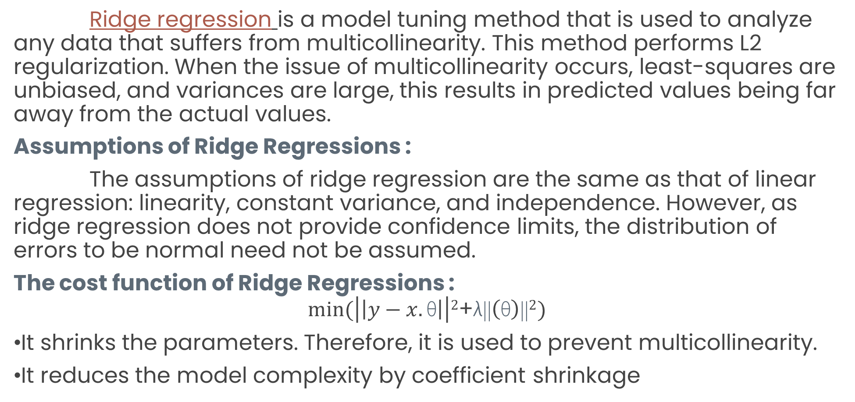
RIDGE REGRESSION
Ridge regression is a model tuning method that is used to analyze any data that suffers from multicollinearity. This method performs L2 regularization. When the issue of multicollinearity occurs, least-squares are unbiased, and variances are large, this results in predicted values being far away from the actual values.
Assumptions of Ridge Regressions :
The assumptions of ridge regression are the same as that of linear regression: linearity, constant variance, and independence. However, as ridge regression does not provide confidence limits, the distribution of errors to be normal need not be assumed.
The cost function of Ridge Regressions :
$$min⁡(\left|\left|y−x.\text{θ}\right|\right|2\text{+}\text{λ}\text{||}\left(\text{θ}\right)\text{||}2)$$
It shrinks the parameters. Therefore, it is used to prevent multicollinearity.
It reduces the model complexity by coefficient shrinkage

Slide 14

LASSO REGRESSION
In Statistics and Machine Learning, lasso (least absolute shrinkage and selection operator; also Lasso or LASSO) is a regression analysis method that performs both variable selection and regularization in order to enhance the prediction accuracy and interpretability of the resulting statistical model.
The Goal is to minimize…
Which is the same as minimizing the sum of squares with constraint Σ |B_{j}≤ s . Some of the βs are shrunk to exactly zero, resulting in a regression model that’s easier to interpret.
A tuning parameter, λ controls the strength of the L1 penalty. λ is basically the amount of shrinkage:
When λ = 0, no parameters are eliminated. The estimate is equal to the one found with linear regression.
As λ increases, more and more coefficients are set to zero and eliminated (theoretically, when λ = ∞, all coefficients are eliminated).
As λ increases, bias increases.
As λ decreases, variance increases.

Slide 15
ONLINE AND OFFLINE
Studies in high-dimensional statistics can be divided into two major streams, the offline and online sparse problems, based on data sampling mechanisms.
The offline problem considers an environment where data are available in its entirety at the beginning and the decision-maker aims to compute a good estimator by solving the corresponding regularized optimization problem.
Online sparse regression considers the environment where data are not readily accessible at the beginning but arrive sequentially. The online problem requires computing a sequence of estimators {βˆt} such that the working estimator can be computed efficiently whenever additional samples arrive. This requires a significantly amount of effort and has been less studied in high dimensional statistics.

Slide 16
CONTRIBUTION
This framework adopts a novel loss function that consists of a squared loss of an initial batch of sample size t₀ and a linearized loss, which enjoys a fixed O(t₀p+p²) memory cost. Meanwhile, the resulting loss function satisfies the RSC(Restricted Strong Convexity) condition throughout all online rounds as long as it holds for the initial batch. This is a significant boost as we do not need it to hold uniformly for all online learning rounds.
By properly choosing the regularization parameters, the estimators are consistent whose (l₁)- norm parameter estimation errors decay to zero in the optimal rate of O ̃(√(s/t)), where t is the streaming sample size and s is the sparsity level.

Slide 17
ALGORITHM
FROM OFFLINE TO ONLINE
ALGORITHM
MEMORY EFFICIENT WEIGHING SCHEME

Slide 18
FROM OFFLINE TO ONLINE
NOTATION:
We first summarize the notation used throughout the paper. For any positive integer K, we write [K] = {1, 2, · · · , K}, the collection of positive integers up to K.
For any two sequences of positive real numbers {a_{n}} and {b_{n}}, we write a_{n} ≲ b_{n} if there exist a constant C > 0 and a positive integer n₀ such that a_{n} ≤ Cb_{n} for all n ≥ n₀.
ASSUMPTIONS:
We consider an online environment where data arrive sequentially.
we only have one single machine that has limited storage and memory.
Assume the covariate vector xi ∈ R^{P} and the response y_{i} ∈ R follow the linear regression model: y_{j} = x_{j}^{T}β∗ + ε_{j}
We consider an online environment where we have access to an initial batch consisting of t₀ independently generated data points (x_{0j} , y_{0j} )_{1≤j≤t0}

Slide 19
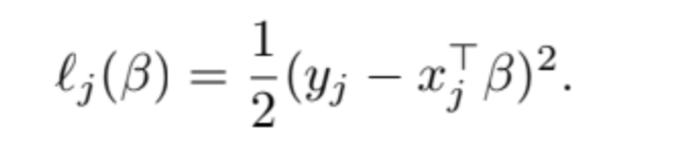
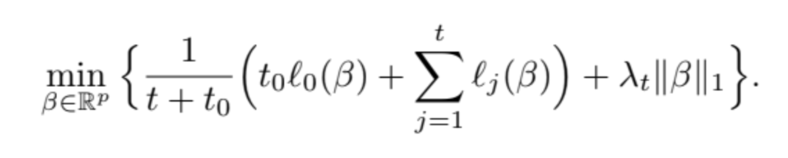
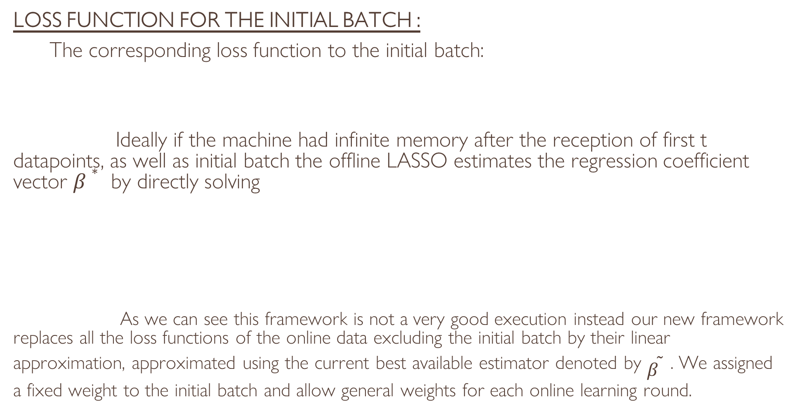
FROM OFFLINE TO ONLINE
LOSS FUNCTION FOR THE INITIAL BATCH :
The corresponding loss function to the initial batch:
Ideally if the machine had infinite memory after the reception of first t datapoints, as well as initial batch the offline LASSO estimates the regression coefficient vector $β∗$ by directly solving
As we can see this framework is not a very good execution instead our new framework replaces all the loss functions of the online data excluding the initial batch by their linear approximation, approximated using the current best available estimator denoted by $\tilde{β}$ . We assigned a fixed weight to the initial batch and allow general weights for each online learning round.

Slide 20
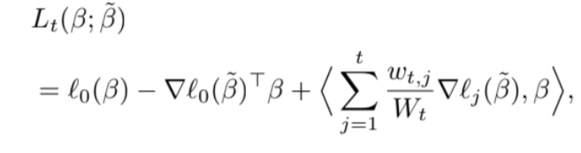
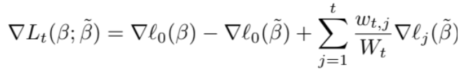
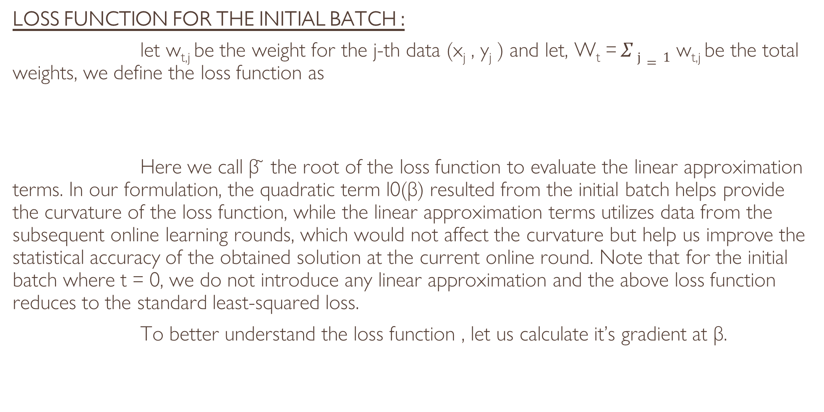
FROM OFFLINE TO ONLINE
LOSS FUNCTION FOR THE INITIAL BATCH :
let w_{t,j} be the weight for the j-th data (x_{j} , y_{j} ) and let, W_{t} = $Σ j=1$ w_{t,j} be the total weights, we define the loss function as
Here we call β ̃ the root of the loss function to evaluate the linear approximation terms. In our formulation, the quadratic term l0(β) resulted from the initial batch helps provide the curvature of the loss function, while the linear approximation terms utilizes data from the subsequent online learning rounds, which would not affect the curvature but help us improve the statistical accuracy of the obtained solution at the current online round. Note that for the initial batch where t = 0, we do not introduce any linear approximation and the above loss function reduces to the standard least-squared loss.
To better understand the loss function , let us calculate it’s gradient at β.

Slide 21
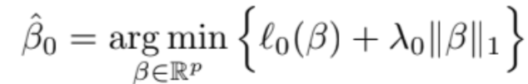

Algorithm
After introducing the loss function, we formally state our algorithm for solving streaming sparse regression. Our online Lasso algorithm consists of the following two stages. In the first stage, we calculate our initial estimator as
Our second stage recursively solves a l₁-regularized optimization problem, with β₀ being the initialization point. Specifically, letting β_{t−1} be the optimal solution obtained for iteration t − 1, upon receiving the t-th data point, we adopt Lt(β; β_{t−1}) as the loss function and solve
We collect the algorithm in Algorithm 1 and refer to this approach as the Online Linearized LASSO (OLin-LASSO). Note the the loss function preserves a simple structure that it is the sum of a quadratic function and a linear term, which can be efficiently solved by various algorithms.

Slide 22



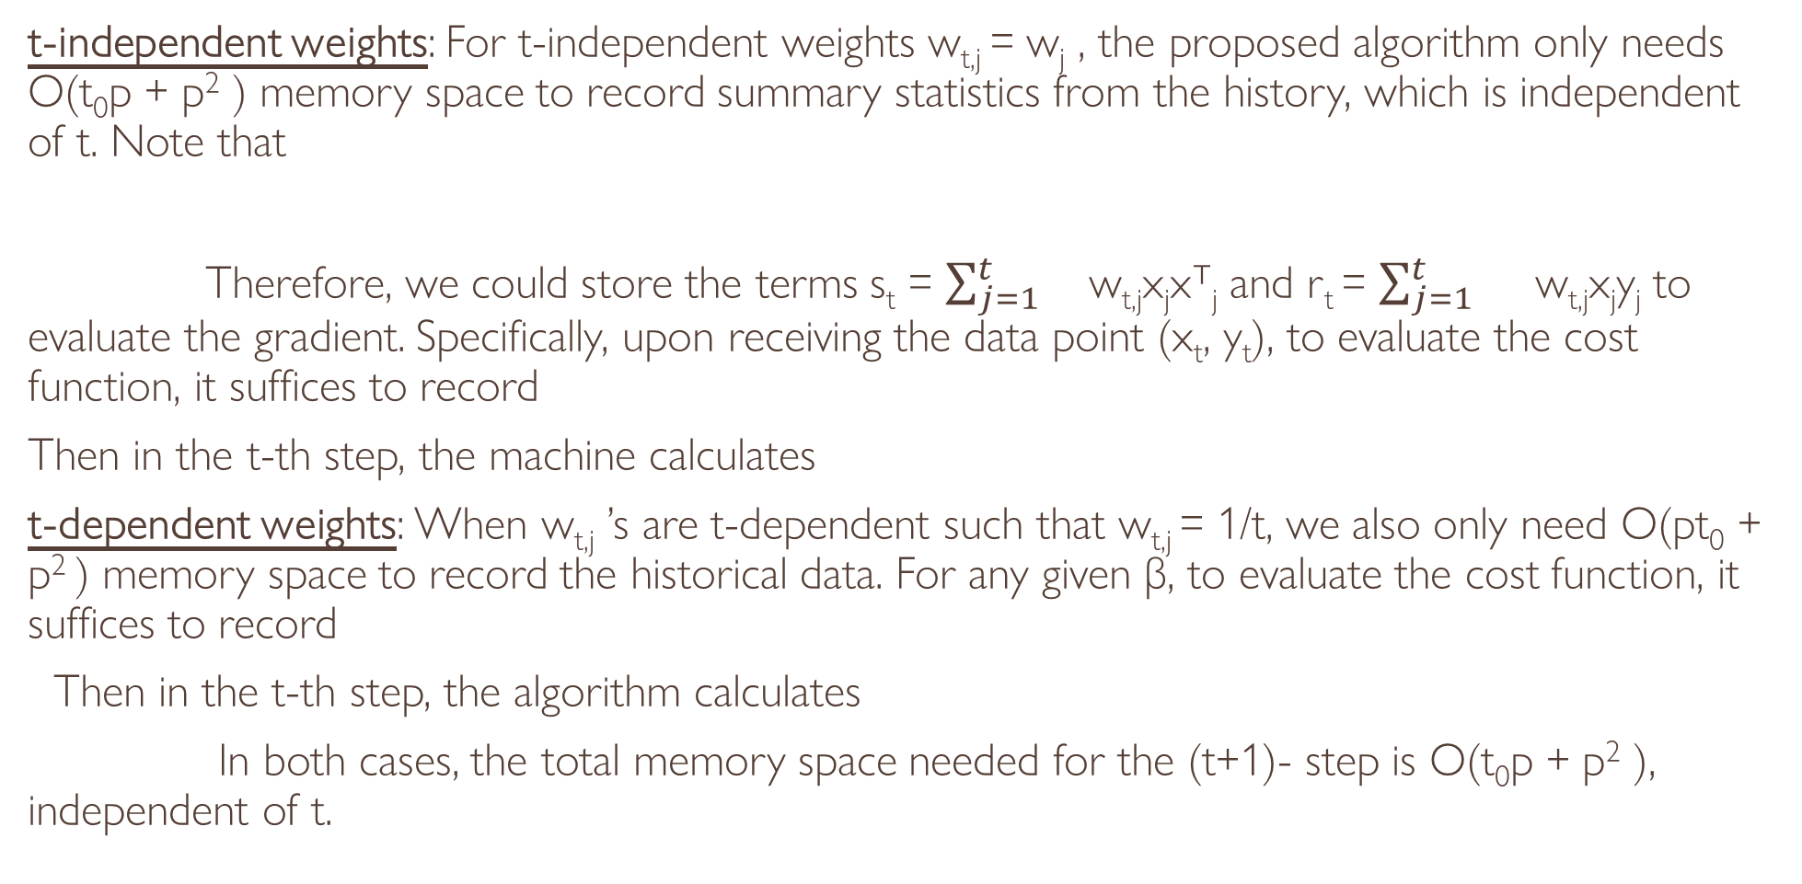
Memory Efficient Weighting Scheme
t-independent weights: For t-independent weights w_{t,j} = w_{j} , the proposed algorithm only needs O(t₀p + p² ) memory space to record summary statistics from the history, which is independent of t. Note that
Therefore, we could store the terms s_{t} = $\sum_{j=1}^{t}{}$w_{t,j}x_{j}x⊤_{j} and r_{t} = $\sum_{j=1}^{t}{}$ w_{t,j}x_{j}y_{j} to evaluate the gradient. Specifically, upon receiving the data point (x_{t}, y_{t}), to evaluate the cost function, it suffices to record
Then in the t-th step, the machine calculates
t-dependent weights: When w_{t,j} ’s are t-dependent such that w_{t,j} = 1/t, we also only need O(pt₀ + p² ) memory space to record the historical data. For any given β, to evaluate the cost function, it suffices to record
Then in the t-th step, the algorithm calculates
In both cases, the total memory space needed for the (t+1)- step is O(t₀p + p² ), independent of t.

Slide 23
CONCLUSION
PROS AND CONS
ACKNOWLEDGEMENT
CREDITS

Slide 24
PROS AND CONS
PROS:
The algorithm exhibits superior practical performance comparing with existing arts under various design correlations. The numerical experiments also aligns with our non asymptotic rate of convergence result well.
CONS:
One possible limitation of our framework is that it requires an initial batch of size t₀ ≥ (96sc/κ)² log(p²/δ) to ensure convergence, where the primitives such as the sparsity level s and the conditional number κ are unknown in practice.
It remains an open problem whether problem-independent algorithms can be developed to avoid the usage of such primitives but still exhibit a comparable performance theoretically.

Slide 25
ACKNOWLEDGEMENT
We are grateful to Professor MALAY BHATTACHARYYA,
who gave us the opportunity to work on such an interesting topic which allowed us to apply the things learnt in the classroom to work with real life data. He has also been instrumental in guiding us through this project by giving feedback and always ushering us to the next step.

Slide 26
CREDITS
AKANKSHA DAS (BS2307)
SOHAN KARMAKAR (BS2349)
UNNATI MANDAL (BS2355)
SOUMYA CHANDA (BS2350)

